Slide 1

accelerating
strategic healthcare
business, clinical & technology operations
performance
Accountable Integrated Care Management
Operational Infrastructure
Health Tech Net Briefing
March 15, 2013

Slide 2
Today’s Discussion
1
The Bottom Line
An Industry in Transition
What is Accountable Integrated Care Management?
AICMSM Architecture
Top 10 AICMSM Operational Infrastructure Challenges
Q&A
Agenda

Slide 3
Bottom Line
2
Accountable Care is happening….so Integrated Care Management is happening.
Accountable Integrated Care Management is expanding in scope along the continuum of health, wellness, and care.
Industry transition is faster than expected but not yet at tipping point (watch out!).
There are no standard business models (yet?).
There are no standard operational infrastructure solutions (yet?).
Bottom Line Up Front

Slide 4
Drivers of Health Care Industry Transition
3
Consumers
Health Information Technology
Clinical Technology
Regulatory
Market | Competition
Financial, Quality, Service Level
&
Compliance Challenges
Integrated Care Management
Value Based Payment
&
Accountable Care
Drivers

Slide 5

Shifting Payment Mechanisms
4
Risk To Payer
Risk To Provider
Industry Transition
Traditional Fee For Service
Traditional Capitation
Fee For Service
Shared Savings
Episodic Bundling
Global Payment

Slide 6
What is Accountable Integrated Care Management (AICMSM)?
5
Industry transition to “Accountable Care” business models where provider reimbursement tied to various quality, cost, and service level outcomes is driving rapid adoption of Integrated Coordinated Care Management approaches and value-oriented solutions.
Between both mandatory and optional government and private payer driven programs this transition is well under way.
AICMSM

Slide 7
What is Accountable Integrated Care Management (AICMSM)?
6
Integrated Care Management expands traditional management of co-morbid chronic disease to integrate with wellness/health management, primary care, and complex acute case management (including home health and recovery), occupational health, and employee assistance.
Accountable Integrated Care Management in turn wraps value based reimbursement and outcomes-oriented performance approaches around integrated coordinated care management.
AICMSM

Slide 8
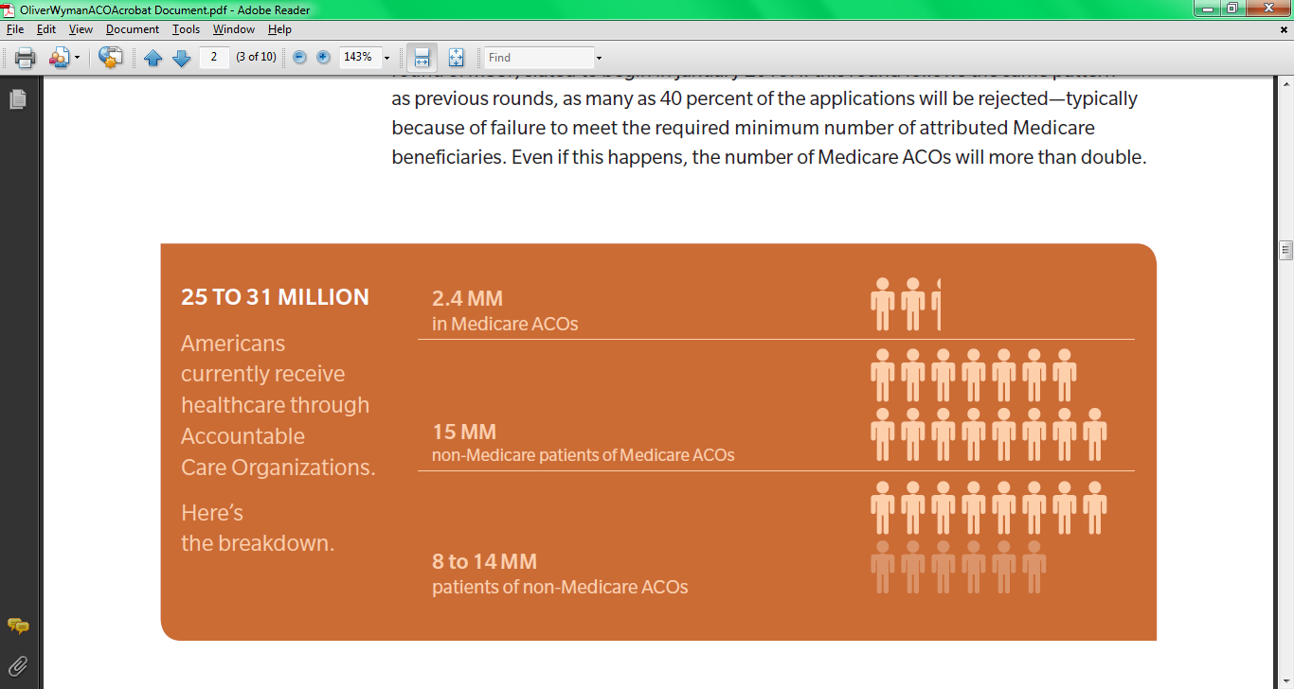
ACO Penetration
7
The Market
© Oliver Wyman, 2012

Slide 9
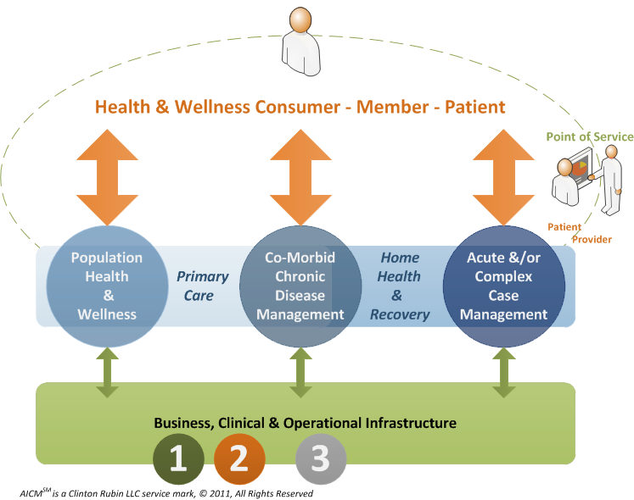
Accountable Integrated Care Management
(AICMSM) Architecture
8
AICMSM Architecture

Slide 10
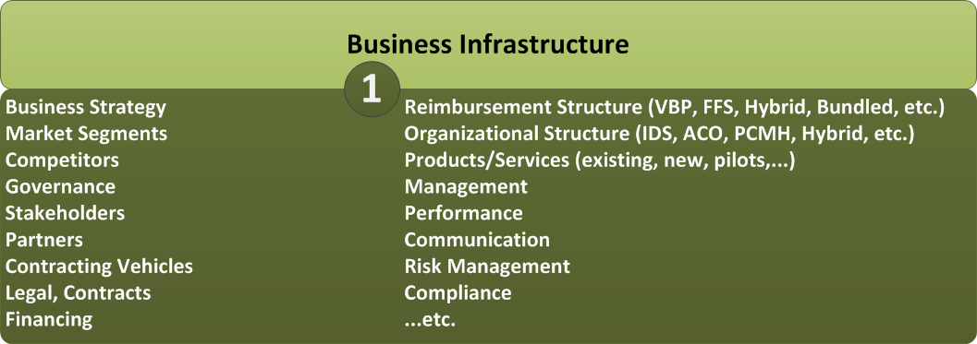
AICMSM Business Infrastructure Considerations
9
AICMSM Architecture

Slide 11
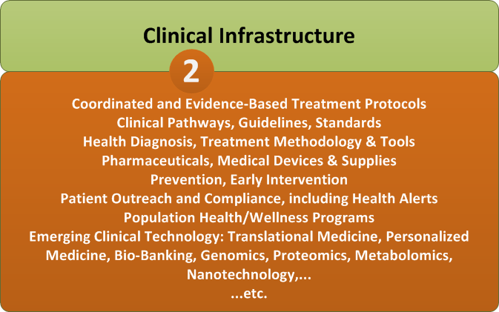
AICMSM Clinical Infrastructure Considerations
10
AICMSM Architecture

Slide 12
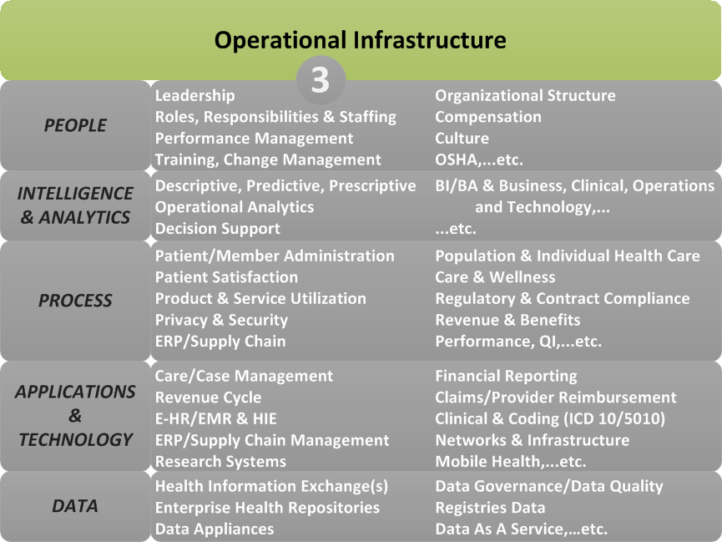
AICMSM Operational Infrastructure Considerations
11
AICMSM Architecture

Slide 13
Top 10 Operational Infrastructure
Challenges & issues
ROI Matters. AICMSM value proposition is expanding to include not just cost management and health outcomes, but productivity, satisfaction, and quality of life. This fact is changing ROI definition, measurement, and recognition.
Integration, Interoperability Opportunities are many. Care integration & coordination opportunities are many, varied, and still being discovered. AICMSM goes way beyond reducing redundant testing, preventing drug interaction, improving discharge planning. AICMSM means a comprehensive understanding of the patient-employee-member: physical, behavioral, social-economic, cultural, educational, etc. – across traditional and non-traditional care settings including the home and workplace.
Challenges & Issues

Slide 14
Top 10 (cont’d)
Market is moving fast. Rapid industry transition – no standard business model design, supporting operational infrastructure requirements, or operational infrastructure solutions. Solution design must be open to build, buy, or borrow (rent) approaches and requires a solution integration versus systems integration approach.
Complexity is high. Operational Infrastructure design and operation is complex and multi-faceted. People-Process-Tools-Facilities must align both strategically AND operationally. Not just with each other but with external ecosystem components including political, regulatory, competitive, community, supplier, and business partner entities.
Challenges & Issues

Slide 15
Top 10 (cont’d)
Value chain integration essential. Operational integration with external suppliers and business partners is a given. This places additional emphasis on partner identification, recruitment, and management including contracting, risk and gain sharing, incentives and service level agreements.
Activity-based attribution controversial. Attribution of provider team member value contribution to an episode of care and matching it to payment distribution is controversial. No standard approach has been developed/accepted.
Challenges & Issues

Slide 16
Top 10 (cont’d)
Management & Technology Practices Core to Operations. Management processes including performance management, data governance, program management, and basic policies & procedures are critical to operations. Build them into the operational infrastructure rather than add them on.
Data-driven Decision Making Vital. Comprehensive Business Intelligence including decision support, operational analytics and clinical informatics capabilities informed by multiple internal and external information and spanning descriptive, predictive, and prescriptive functionality is critical and difficult.
Challenges & Issues

Slide 17
Top 10 (cont’d)
Efficient & Effective Data Integration is THE BIGGEST challenge. Data integration from a growing number of multiple non standardized sources is the biggest challenge to AICM. The larger continuum of care to provide data sources of interest, more data collection devices, more data in digital form, more data available in real time, all conspire to overwhelm traditional (last couple of years) data aggregation and mining approaches. New “big data” approaches where quantity may trump quality; where correlation may trump causation, etc. must be approached carefully but must be approached.
Challenges & Issues

Slide 18
Top 10 (cont’d)
Scarce Resources. Resource availability to design, build (or buy), and operate the new business models and supporting operational infrastructure are scarce and expensive. But not using expert help can be VERY expensive.
Challenges & Issues

Slide 19
18
Questions?

Slide 20
Need more information?
Scott Pickens
Clinton Rubin LLC Global Healthcare Practice Lead, Managing Partner
Scott.Pickens@clintonrubin.com
703-887-6615
Jamie Beth Solak
Clinton Rubin LLC Global Healthcare Practice Partner
Jamie.Solak@clintonrubin.com
703-967-1440
Websites
www.ClintonRubin.com
www.McConnellInternational.com

